Slide 1
Personal Software Process (PSP)

Slide 2
The Changing World of Software
Software now controls most business, government, and military systems.
    Factories are managed by software
    Most advanced products are controlled by software
    Finance, administrative, and business operations are largely run by software
The cost, schedule, and quality of software is now a critical business concern.

Slide 3
Big Software Projects Usually Fail
With increased size, projects are more troubled.
Project Size | People | Time (Months) | Success Rate
Less than $750K | 6 | 6 | 55%
$750K to $1.5M | 12 | 9 | 33%
$1.5M to $3M | 25 | 12 | 25%
$3M to $6M | 40 | 18 | 15%
$6M to $10M | +250 | +24 | 8%
Over $10M | +500 | +36 | 0%
This is a problem of scale: current software practices do not scale up.
Standish: Chaos Reports, 1999

Slide 4
Why Projects Fail -1
Large and small software projects fail for four reasons.
  Project commitments are often unrealistic
  The larger the project, the less influence we have
  If we don’t have anything to say, nobody will listen
  Larger projects are harder to control
Today, few developers have personal plans
Without a plan, you cannot know job status
If you don’t know where you are, management can’t understand job status
If management doesn’t understand job status, they can’t manage projects

Slide 5
Why Projects Fail -2
Quality problems get worse with project size
In software systems, if any part has quality problems, the system will have quality problems
If the developers do not manage quality, their teams cannot manage quality
When unmanaged, quality will always be poor
To be effective, teams need leadership and coaching
Leaders build team motivation and commitment
Coaching develops team cohesion
Cohesive, motivated, and committed teams do the best work

Slide 6
The Need for Change
Many lives and businesses now depend on software.
We now need larger, more complex, and safer software systems on predictable schedules.
Without different software practices, this will not happen.
The Team Software Process (TSP) addresses this need.
The PSP provides the knowledge and skill that developers need to work on TSP teams.

Slide 7
PSP Principles - 1
The quality of a software system is determined by the quality of its worst components
The quality of a software component is governed by the individual who developed it
The quality of a software component is governed by the quality of the process used to develop it
The key to quality is the individual developer’s skill, commitment, and personal process discipline

Slide 8
PSP Principles - 2
As a software professional, you are responsible for your personal process
You should measure, track, and analyze your work
You should learn from your performance variations
You should incorporate lessons learned into your personal practices

Slide 9
What Does PSP Provide?
A stable, mature PSP allows you to
  estimate and plan your work
  meet your commitments
  resist unreasonable commitment pressures
You will also
  understand your current performance
  be better equipped to improve your capability

Slide 10
What Does PSP Provide?
The PSP provides
  a proven basis for developing and using an industrial-strength personal process
  a discipline that shows you how to improve your personal process
  the data to continually improve the productivity, quality, and predictability of your work

Slide 11
What is the PSP?
The PSP is a personal process for developing software or for doing any other defined activity. The PSP includes
  defined steps
  forms
  standards
It provides a measurement and analysis framework for characterizing and managing your personal work.
It is also a defined procedure that helps you to improve your personal performance.

Slide 12
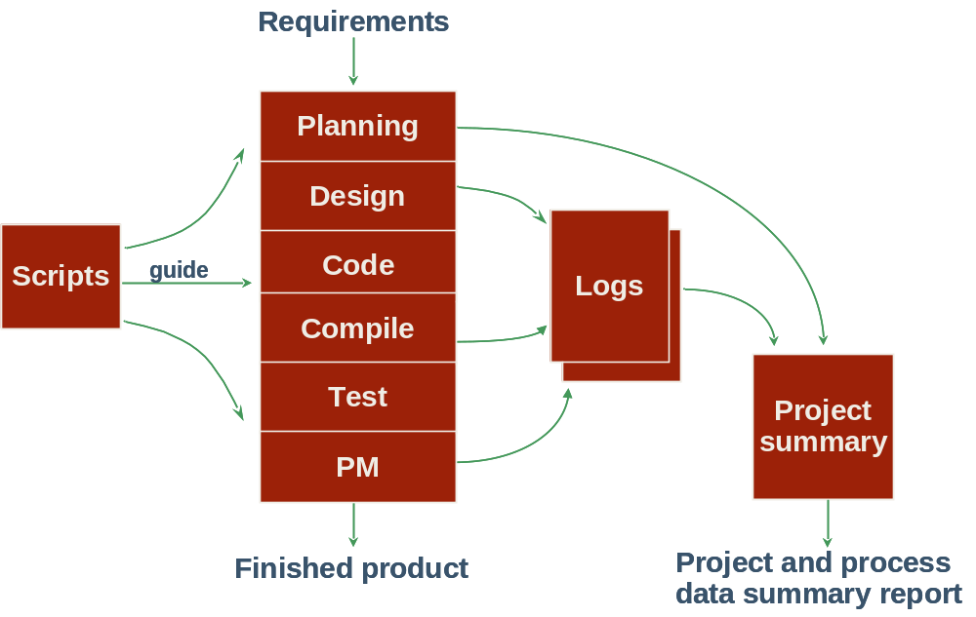
The PSP Process Flow

Slide 13
Learning the PSP - 1
The PSP is introduced in six upward-compatible steps
You write one or more module-sized programs at each step
You gather and analyze data on your work
You use the results to improve your personal performance

Slide 14
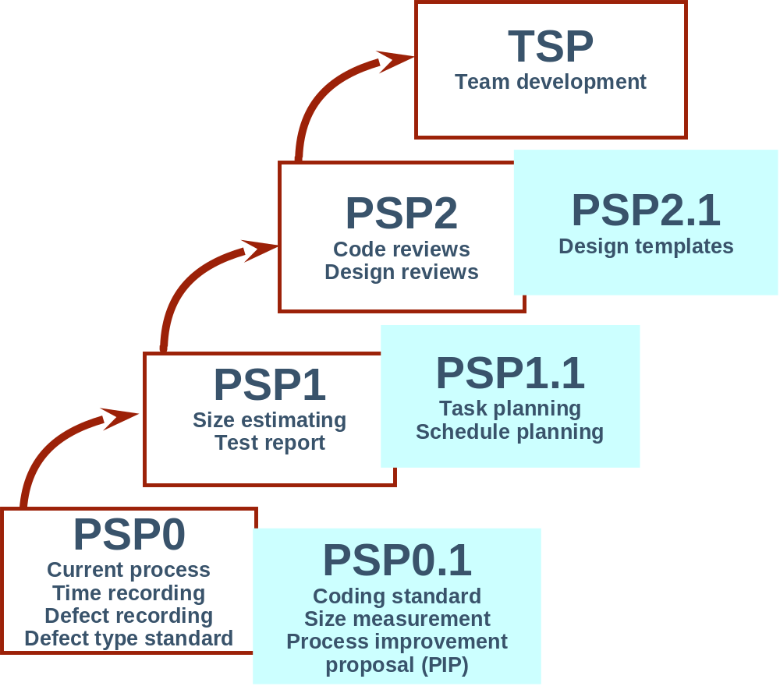
Learning the PSP - 2

Slide 15
Learning the PSP - 3
PSP0: You establish a measured performance baseline.
PSP1: You make size, resource, and schedule plans.
PSP2: You practice defect and yield management.

Slide 16
Phase Order
The PSP looks like a waterfall process but it’s not
The phase order is determined by the dependencies between phases
  You can’t test the code before it’s compiled
  You can’t compile the code before it’s written
  You can’t use the design if it’s produced after the code is written
  There’s no reason to make a plan after you’re done
Conclusion…start here with a plan
Test
Compile
Code
Design
Plan

Slide 17
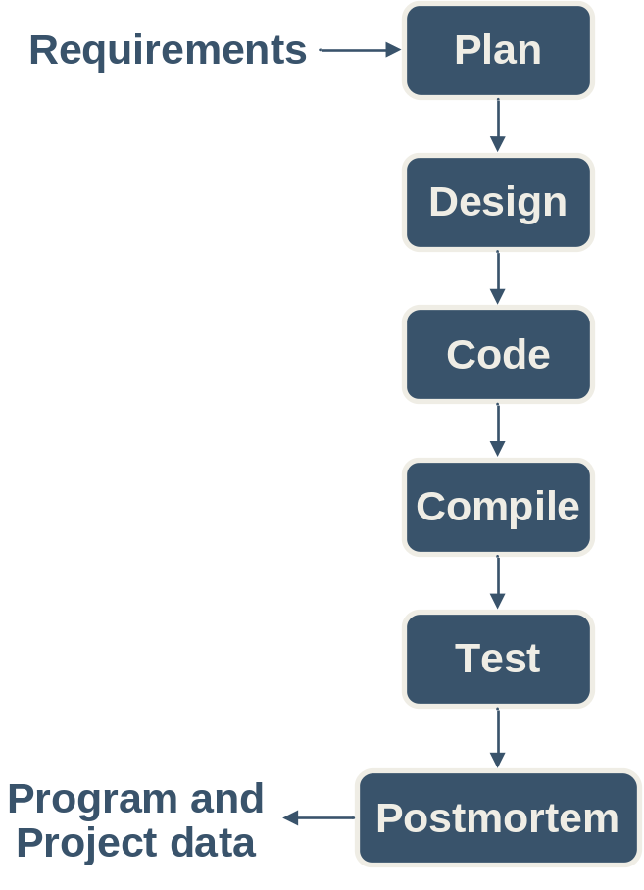
Process Flow
When programs are small or well understood, you can execute the phases in order
Produce a plan
Design all modules
Code all modules
Compile the coded program
Summarize the project data during the postmortem

Slide 18
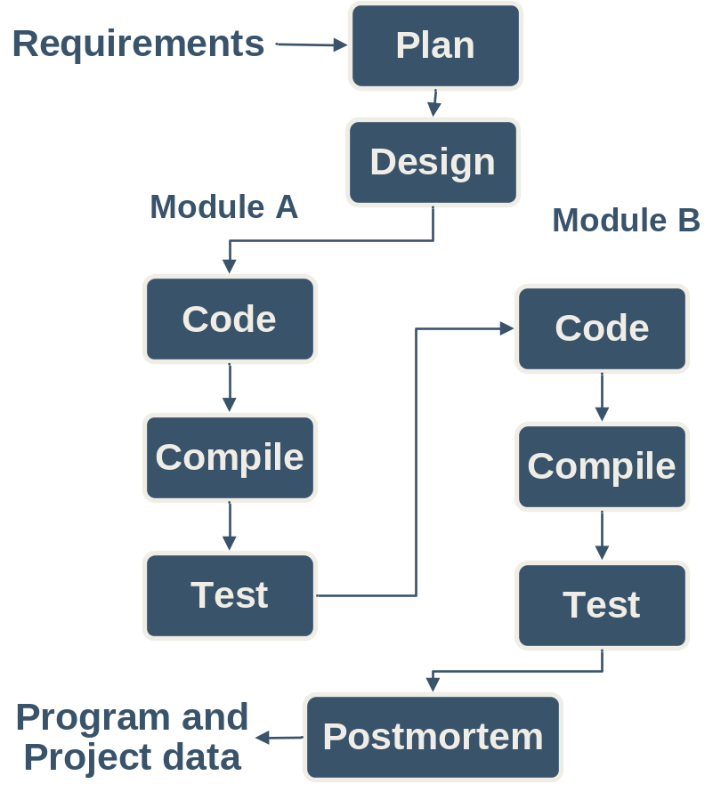
Cyclic Process Flow -1
Large programs or those that are not well understood may require an iterative approach
In this example the design is completed in one step
Two modules are identified during the design, modules A and B
Then each module is separately coded, compiled, and tested
This example uses the PSP0 phases and two cycles of code-compile-test

Slide 19
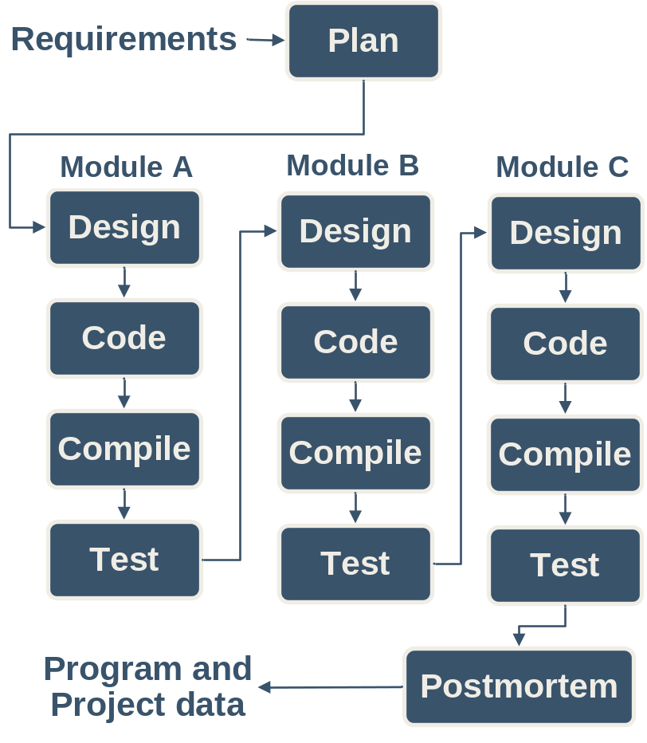
Cyclic Process Flow -2
There can be more than two cycles and cycles can also include the design phase as in this example.
Note that each cycle is focused on producing part of the program, e.g. Module A, Module B, Module C.
Part size is a key factor for determining cycles.
  a line of code is too small
  a program may be too large
One or more classes, methods, procedures, or functions are probably the right size.
You need to determine what works for you.

Slide 20
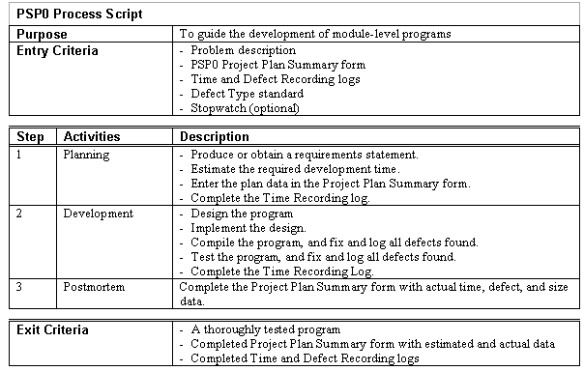
Process Scripts
Process scripts provide “expert-level” guidance on how to use the process
They are one or two pages long.
They describe the
  Purpose
  Entry criteria
  General guidelines
  Steps
  Exit criteria

Slide 21
The PSP0 Scripts - 1
Planning: Estimate the development time
Development: Develop the product using your current methods
Postmortem: Complete the project plan summary with the time spent and defects found and injected in each phase.

Slide 22
The PSP0 Scripts -2
Design: Design the program using your current design methods
Coding: Implement the program
Compile: Compile until defect-free
Test: Test the program and fix all defects
Record defects in the defect log and time per phase in the time log

Slide 23
Using Process Scripts
Process scripts guide you through the process.
You should
    check the entry criteria before starting a phase
    record the phase start time
    perform the phase steps and instructions
    record defects as they are found and corrected
    check the exit criteria before ending a phase
    record the phase end time
    go to the next phase
Force yourself to use this paradigm until it becomes a habit.

Slide 24
PSP0 Measures and Forms
PSP0 measures
    Time – track time in phase
    Defects – record defects as they are found and fixed
PSP0 has four forms
    PSP0 Project Plan Summary – summarizes planned and actual time and defects by phase
    PSP0 Time Recording Log – used to record time
    PSP0 Defect Recording Log – used to record defects
    PSP0 Defect Type Standard – used to define standard defect types

